Slide 1
RNAseq: beyond gene expression
Siyuan Zheng, PhD
zhengs3@uthscsa.edu
Zhenglab.info

Slide 2
What you have learned so far
R - basic grammar, data visualization
RNAseq
Data structure
Alignment, expression quantification
Differential expression
Public resources
Linux shell commands

Slide 3
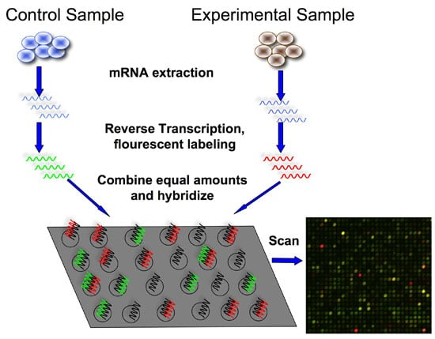
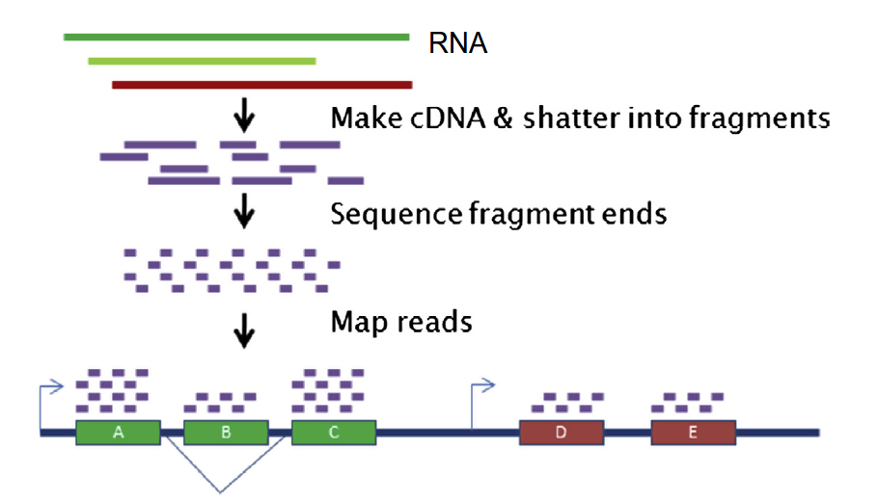
Gene expression is only one type of information from RNAseq
microarray
RNAseq
The key difference: microarray is “fishing” with a “bait”, whereas RNAseq is “capture all” (this has pros and cons!!!)

Slide 4
What A/T/G/C can reveal?
Reads are derived from transcript (cDNA) segments
Each read has two fundamental features, count and nucleotide seq.
Expression
Allele specific expression
Variants (mutations, RNA editing)
Aberrations in RNA will be copied into these reads
Chimeric transcript
Alternative splicing

Slide 5
Factors affecting RNAseq performance
Total amount of reads (sequencing output)
Read length
Paired end or single end
Reference genome (gene model)
Assuming no tech glitches in experiments!

Slide 6
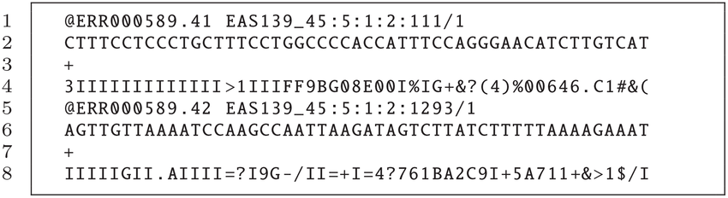
“One” read is not equal to “one”
Read ID
Read seq from machine
Quality score
A separator

Slide 7
How A/T/G/C bring in additional info?
Understanding the analysis procedure is key to understanding how the sequences are used.
With vs without a reference genome
Transcription is directional
In a nutshell
5’
3’
intron
intron
intron
AAAAAA
Gene in genome/before splicing
Exon 2
Exon 3
5’ UTR
TSS
Stop codon
3’ UTR
Exon 1
Exon 5

Slide 8
A little bit deeper
5’
intron
intron
intron
3’
Gene in genome/before splicing
(this is what we have in the reference)
Mature mRNA/cDNA
(this is what we sequence)
random fragmentation
In a perfect world scenario, what we can expect:
Reads are aligned to exons or junctions, not introns
All pairs aligned to the same transcript
All pairs follow expected insert size
All pairs follow expected orientation (F1R2 or R1F2)
All nucleotides match those of the ref
New intron
Fusion
Alter splicing, read through
Fusion
Mutation, editing

Slide 9
Read orientation
F read
5’
3’
3’
5’
R read
F and R can be either read 1 or read 2
A normal pair is always one F, one R
Orientation abnormality has a lot to do with structural changes
Whether the transcript is on F or R strand matters!
http://software.broadinstitute.org/software/igv/interpreting_pair_orientations

Slide 10
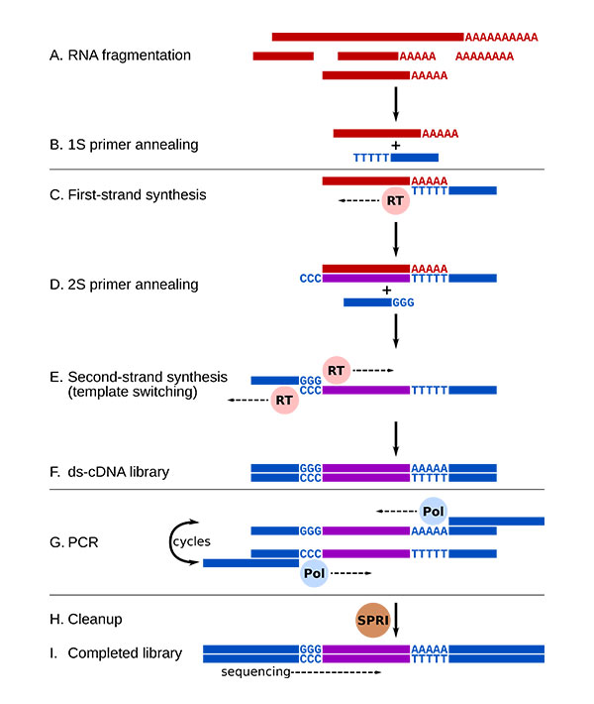
Caveats in RNA sequencing
Fragmentation may be not uniformly random
cDNA synthesis introduces artificial nucleotide subs
(RNAseq has less fidelity than DNAseq in nucleotides)
PCR efficiency may vary for different transcripts
Image from RNAseq blog
Further read: Sendler et al. Anal Biochem. 2011.

Slide 11
Gene fusions are among the first successful molecular targets in cancer therapy
Gene fusions, as the name suggests, are events where two distinct genes are abnormally joined to produce a new transcript.
Gene fusions are commonly seen in human cancer.
They are more often in children than adults.
They are generally infrequent but can be the major driver for certain types of cancers.

Slide 12
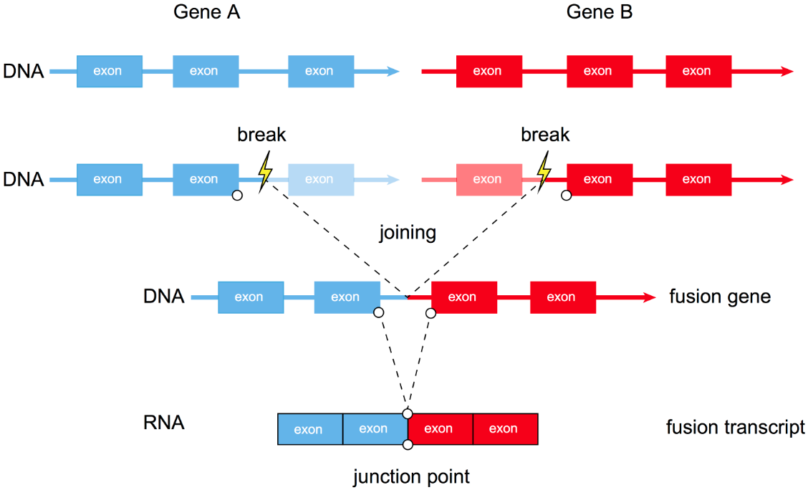
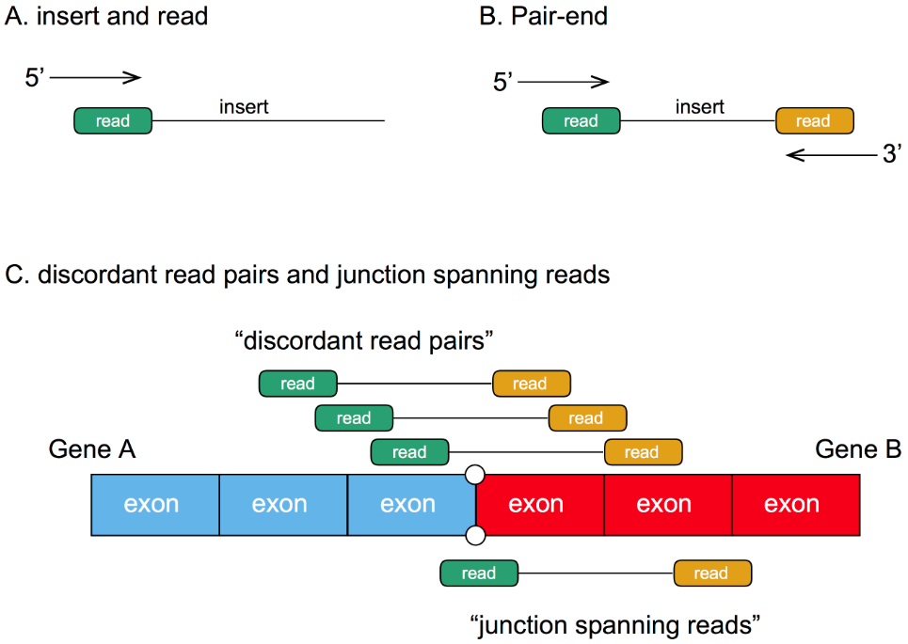
Identifying gene fusions
Do you have reference genome?
Do you trust gene model annotations?
How long are your reads? Paired end or single end?
Ref: Tumorfusions.org

Slide 13
Tools to call fusions
More than two dozens of tools are available
It is wise to use more than one tools when calling fusion
PRADA
STAR-Fusion
FusionCatcher
defuse
EricScript
Tophat-Fusion
JAFFA
…

Slide 14
Common issues with fusion calling
Missing fusions (mitigated by multiple callers)
Filtering artifacts
It is often too many fusions are called
Tumor vs normal (remove those seen in normal)
Highly expressed genes (fusion allelic fraction)
Genes with high similar sequences
Identical junctions
Too many fusion partner genes
Positive/negative list

Slide 15
Extending expression analysis
Expression can be considered “functional readout” of genetic and epigenetic changes
Expression bridges genetics and proteomics (central dogma)
Integrating expression with other types of data allows one to:
Test whether any particular genetic change alters expression
Test whether expression of a gene can be a marker of prognosis, response to drugs
Find robust molecular subtypes
Delineate regulations (eQTL, cis and trans regulatory elements, co-expression)
Delineate cellular compositions
…

Slide 16
What is next
Visualizing fusion events/RNAseq data in IGV
Download IGV before the lecture
Make sure you have java installed properly for IGV to launch.
BAM and BAI files are both needed.
Walk through a few websites for expression analysis (if time permits).
PCAT, R2
cBio
Fusion portal

